Slide 1
SACRAMENTO, CALIFORNIA
MAY, 23 2011
INVESTIGATORY HEARING
REGARDING PRACTICES OF
METROPOLITAN LIFE INSURANCECOMPANY
Conducted by the California Insurance Commissioner
and the California State Controller

Slide 2
Purpose of Hearing
The California Commissioner and Controller are conducting this hearing to evaluate potential industry-wide practices related to:
Life insurance and annuities claims settlement issues;
Use of the United States Social Security Administration’s
“Death Master” file by life insurance companies;
Compliance with California’s Unfair Claims Practices
Law and other insurance statutes; and
Compliance with California’s unclaimed property laws.

Slide 3
Life Insurance Policies
What is a life insurance policy?
Two primary types of life insurance: term and whole life.
In a term life policy, the insured pays a premium for a limited period of time. If the insured dies when the policy is in force, a death benefit is paid. There is no cash value. The policy lapses and no death benefit is paid after premium payments end.
In a whole life policy, the insured pays a premium. In addition to offering a death benefit, the policy builds up a cash value. If an insured stops paying premiums, the insurer may pay itself premium out of the cash value. The policy pays a death benefit so long as the policy is in force through one of the premium sources.
Group life insurance is either term or whole life insurance covering a group of people, usually employees of a company or members of a defined group.
Because benefits generally do not become due until many years or decades in the future, a life policy is a long-term promise by an insurer.

Slide 4
Annuity Contracts
What is an annuity contract?
A contract between an owner and an insurer, where, in exchange for premium payments, the insurer promises to make periodic payments to an annuitant.
There are many different types of annuities. All annuities are in either the “pay-in” or deferred status, or the “pay-out” or annuitized status.
Payments begin on a maturity date or annuity commencement date.
Payments may be for a guaranteed period, for life, or for both.
Payments generally also due upon death of the owner or annuitant.
Payments may not become due until many years in the future and also may include a death benefit, making an annuity contract a long term promise by the insurer.

Slide 5
The Problem of Unpaid Benefits
The existence of unpaid benefits is a serious problem in the life insurance industry.
“ . . . hundreds of millions of dollars in life insurance goes unclaimed each year for one simple reason: the beneficiaries do not know the money exists.”
“It is difficult to accurately estimate the extent of
unclaimed life insurance policies.”
“‘Whether the companies have good recordkeeping I
honestly don’t know, but I strongly doubt it.’” (quoting Joseph M. Belth, Professor Emeritus of
Insurance at Indiana University)
New York Times, February 25, 2011

Slide 6
Potential Violations of California’s Insurance Laws
The Department is looking to determine whether certain life insurance industry practices violate California’s insurance laws
Pursuant to California insurance law, an insurance company engages in unfair claims settlement practice by:
“Failing to adopt and implement reasonable standards for the prompt investigation and processing of claims arising under insurance policies,” and
“Not attempting in good faith to effectuate prompt, fair, and equitable settlements of claims in which liability has become reasonably clear.” Cal. Ins. Code § 790.03(h)(3),(5).
“Whenever possible payment shall be made within 30 days after the date of death of the insured.”
Cal. Ins. Code § 10172.5(b).
“In any case in which interest on the proceeds of, or payments under, any policy of life insurance, credit life insurance, or accidental death insurance becomes payable pursuant to subdivision (a), the insurer shall notify the named beneficiary or beneficiaries at their last known address that interest will be paid on the proceeds of, or payments under, that policy from the date of death of the named insured.” Cal. Ins. Code § 10172.5(c).
“[Any insurer] that fails or refuses to pay the proceeds of, or payments under, any policy of life insurance issued by it within 30 days after the date of death of the insured shall pay interest, at a rate not less than the then current rate of interest on death proceeds left on deposit with the insurer computed from the date of the insured's death…” Cal. Ins. Code § 10172.5(a).

Slide 7
Potential Violations of California’s Insurance Laws
The Department is looking to determine whether certain life insurance industry practices violate California’s insurance laws
“[T]he commissioner shall consider the qualifications of said applicant in respect to the
following subjects… (e) competency, character, and integrity of management; (g) whether claims under policies are promptly and fairly adjusted and are promptly and fully paid in
accordance with law and the terms of policies; (h) fairness and honesty of methods of doing business; and (j) hazard to policyholders or creditors.” Cal. Ins. Code § 717.
“The commissioner may suspend the certificate of authority of an insurer for not exceeding one year whenever he finds, after proper hearing following notice, that such insurer engages in any of the following practices: * * * (b) Not carrying out its contracts in good faith.” Cal. Ins. Code § 704 .

Slide 8
Potential Violations of California’s Unclaimed Property Laws
The Controller is looking to determine whether insurance companies are complying with their obligations to escheat unclaimed death benefits, matured annuity contracts, and retained asset accounts as required by California’s unclaimed property laws.
Pursuant to California unclaimed property law:
“[F]unds held or owing by a life insurance corporation under any life or endowment insurance policy or annuity contract which has matured or terminated escheat to this state if unclaimed and unpaid for more than three years after the funds became due and payable as established from the records of the corporation.” Cal. C.C.P. § 1515(a).
Escheat refers to a process by which the state acquires custody of property that is unclaimed or presumed abandoned by the rightful owner.
As the US Supreme Court has held, if the states do not take possession of unclaimed benefits,
“the insurance companies would retain moneys contracted to be paid on condition and which normally they would have been required to pay. […] The fact that claimants against the companies would under the policies be required to comply with certain policy conditions does not affect our conclusion. The state may more properly be custodian and beneficiary of abandoned property than any person.” Connecticut Mut. Life Ins. Co. v. Moore, 333 U.S. 541, 546 (1948).

Slide 9
What The Commissioner and Controller Are Looking to Determine
The Commissioner and Controller are looking to determine whether insurance companies:
Have information indicating that customers are deceased with active policies or accounts, but fail to act upon this information, except when it is in their best interest to do so.
Fail to pay death benefits or escheat unclaimed death benefits in situations where the insurance company has information that individuals have died with in-force policies or accounts, but beneficiaries have not filed claims because they are unaware of the policy.
Do not have adequate controls to monitor when retained asset accounts have been dormant for years, so they can locate the account owner or escheat the proceeds if the owner cannot be found.
A “retained asset account” or “RAA” is an account set up by an insurance company as a settlement option for death benefits instead of paying the beneficiary a lump sum.

Slide 10
Different Ways Insurers Become Aware of the Death of Their Customers
Insurance companies may become aware of the death of an insured or annuitant from a variety of sources, even before a claim is filed:
Calls or letters from relatives or representatives of the decedent.
Results of searches performed for new addresses of customers following the receipt of returned mail.
Claims filed and/or death certificates received in connection with other policies or contracts insuring the same decedent.
Information contained in or derived from publicly available databases, including the United States Social Security Administration Death Master File (the “Death Master File”).

Slide 11
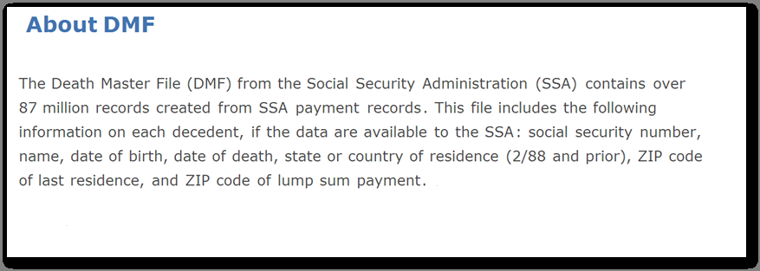
What is the Death Master File?
One of the most prevalent forms of death information available to insurers is information from the Death Master File.

Slide 12
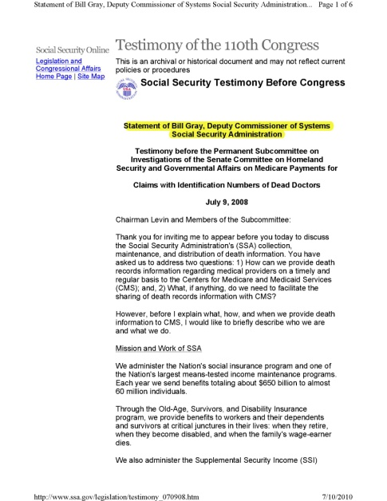
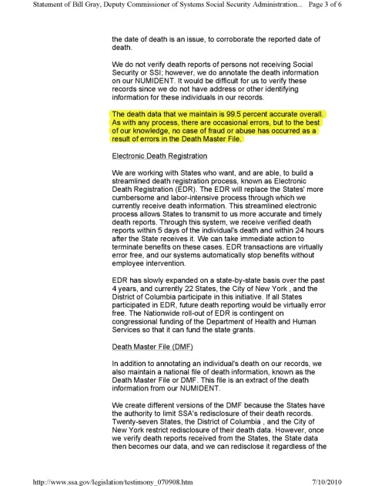
The Death Master File Is 99.5% Accurate
Congressional testimony indicates that death listings contained in the Death Master File are extremely reliable and not subject to fraud.

Slide 13
How is the Death Master File Accessed?
Insurers may access the Death Master File in a variety of ways.

Slide 14
Potential Selective Use of The Death Master File
Insurers may use the Death Master File for a variety of purposes.
Insurance companies may use the Death Master File to:
Perform anti-fraud procedures.
Verify dates of death prior to paying out on a policy.
Perform “death sweeps” of large corporate owned accounts.
Perform regular comparisons against their records to identify
deceased annuitants in the “payout” phase and to stop making
payments under their contracts.
But do they run the Death Master File on a regular basis
against their life insurance policies?

Slide 15
What Happens After a Death File Match?
If the death of an insured is identified on the Death Master File, are insurers allowing death benefits to go unpaid and unreported?
Do insurers allow death benefits to go unreported as unclaimed property even when they know through the Death Master File that an insured has died?
Do insurers use policy cash values to pay themselves premium after the death of the insured (even when death has been confirmed on the Death Master File)?

Slide 16
Other Death Information in Policy Files
Do insurers act on other death information in their policy files if a claim remains unperfected?
What do insurers do in the following situations?
Example 1
A phone call or letter is received from a relative reporting the death of an insured,
but a claim is never filed or is not perfected.
Example 2
A death certificate and claim form are received from one of several beneficiaries,
but not all beneficiaries file a claim or they fail to perfect their claims.
Example 3
A search for a new address following receipt of returned mail indicates
the insured is deceased, but a claim is never filed or is not perfected.

Slide 17
Policies Kept In-Force After Death
Do insurers allow the built-up cash value of life policies to be used to keep policies in-force after the insureds have died and/or allow policies to terminate or lapse after the cash value has been drained?
Example
An insured dies in 1995 with her policy in force, but no claim is ever filed.
Six months later, the policy is set to expire due to failure to pay premiums.
Although the insured is listed in the Death Master File as deceased, the insurer
begins to withdraw premium from the cash value of the policy to keep the policy
in force.
Five years later, the cash value of the policy has been used up, and the policy
is allowed to expire without any value.

Slide 18
Dormancy Period Calculations for Escheatment
Do insurers calculate the “dormancy period” for escheatment (e.g., the number of years a claim must remain unpaid before it is considered escheatable) based on something other than the actual date of death?
Example
An insured dies in 1989 with his policy in force, but no claim is ever filed.
A Death Master File comparison performed in 2009 identifies the death of the insured
20 years earlier.
The insurer verifies that the insured died while his policy was in force and no benefits
have ever been paid.
When will the insurer consider the proceeds due to be escheated?
Improper calculation of the “dormancy period” allows insurers to unlawfully retain millions of dollars in proceeds for years, if not decades, after they are due to be escheated.

Slide 19
Demutualized Insurance Companies
Beginning in the late 1990s, many large insurance companies “demutualized,” which required attempts to contact all of their in-force policyholders.
Large demutualized insurance companies publicly acknowledged that
they had lost contact with up to one million or more of their
policyholders.
What searches, including comparisons against the Death Master File,
did these insurers perform that allowed them to identify which of these
“lost” policyholders were deceased?
What did these insurers do if they determined that an insured was
deceased?
Over a decade later, are these insurers holding onto unclaimed death
benefits due to any of these “lost” and dead policyholders?

Slide 20
Industrial Policies
Industrial Life Insurance: Small face value policies often sold door-to-door with premiums collected weekly or monthly. These policies were marketed to lower income consumers and sometimes ended up costing more in premiums than the policies were worth.
Millions of industrial policies remain in force industry-wide.
What is the quality of the record keeping for these policies, many of which
were issued 50 years ago or more?
What did these insurers do if they determined that an insured was
deceased?
What have insurance companies done to determine which of the
insureds under these policies are deceased and benefits are due?

Slide 21
Adequacy of Procedures Related to Retained Asset Accounts
$28 billion is held in RAAs by life insurance companies industry-wide.
Many insurers use RAAs as the default settlement option unless
the beneficiary affirmatively requests a different method of payment.
Insurers often describe the purpose of RAAs as being a short-term
option that allows beneficiaries time to decide what to do with the
money following the death of the insured.
Many insurers hold the funds in their general corporate accounts
and RAAs are not guaranteed by the FDIC.

Slide 22
Public Comments
MetlifePublicHearingCmnts@insurance.ca.gov

